Slide 1
Electronic Devices
Final Term Lecture - 07
Reference book:
Electronic Devices and Circuit Theory (Chapter-7)
Robert L. Boylestad and L. Nashelsky , (11th Edition)

Slide 2
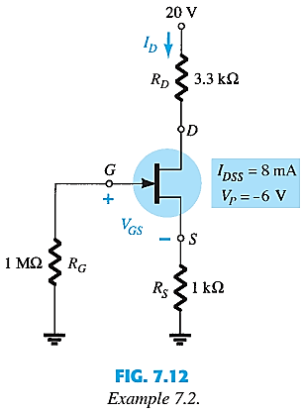
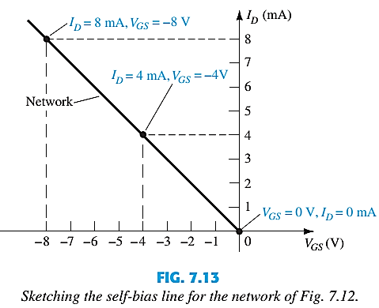
SELF-BIAS EXAMPLE Contd.
Plot I_{D} vs V_{GS} and draw a line from the origin of the axis.

Slide 3
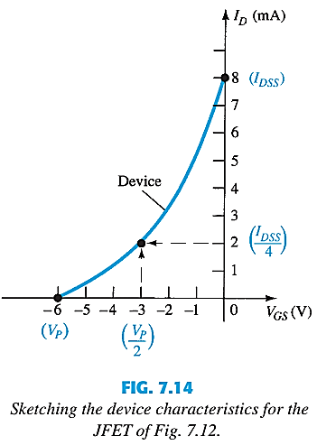
SELF-BIAS EXAMPLE Contd.
Plot the transfer curve using I_{DSS} and V_{P} using shorthand method:
V_{GS} | I_{D}
0 | I_{DSS}
0.3V_{P} | I_{DSS}/2
0.5V_{P} | I_{DSS}/4
V_{P} | 0mA

Slide 4
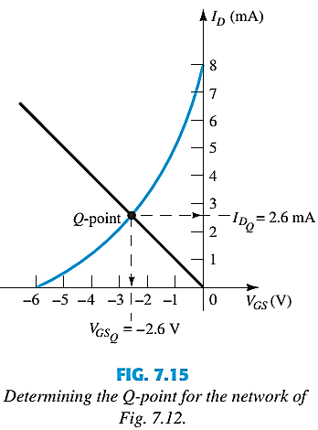




SELF-BIAS EXAMPLE Contd.
Superimpose the load line on top of the transfer curve:

Slide 5

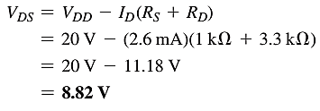


SELF-BIAS EXAMPLE Contd
Determine V_{GSQ}, I_{DQ},V_{DS},V_{S},V_{G} and V_{D}.

Slide 6
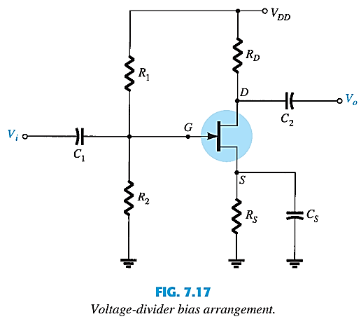
JFET: VOLTAGE-DIVIDER BIAS
The source V_{DD} was separated into two equivalent sources to permit a further separation of the input and output regions of the network.
Since I_{G} = 0A, Kirchoff’s current law requires that I_{R1}= I_{R2} and the series equivalent circuit appearing to the left of the figure can be used to find the level of V_{G}.

Slide 7
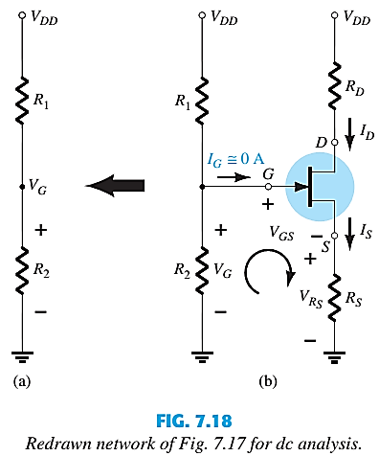
VOLTAGE-DIVIDER BIAS
V_{G} can be found using the voltage divider rule:
Using Kirchoff’s Law on the input loop:
Rearranging and using I_{D} =I_{S}:
Again the Q point needs to be established by plotting a line that intersects the transfer curve.

Slide 8
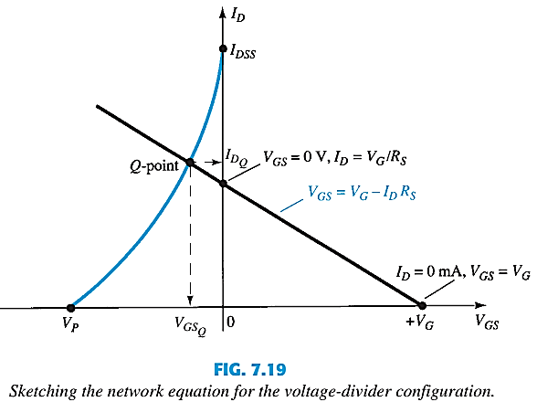
VOLTAGE-DIVIDER BIAS
Graphical Approach ( to find V_{GSQ} and I_{DQ}):
Plot a line for:
V_{GS} = V_{G} when I_{D} = 0A
V_{GS} = 0V when I_{D} = V_{G}/R_{S}.
Plot the transfer curve using I_{DSS} and V_{P} using shorthand method.
The Q-point is located at the intersection.
V_{GS} | I_{D}
0 | I_{DSS}
0.3V_{P} | I_{DSS}/2
0.5V_{P} | I_{DSS}/4
V_{P} | 0mA

Slide 9
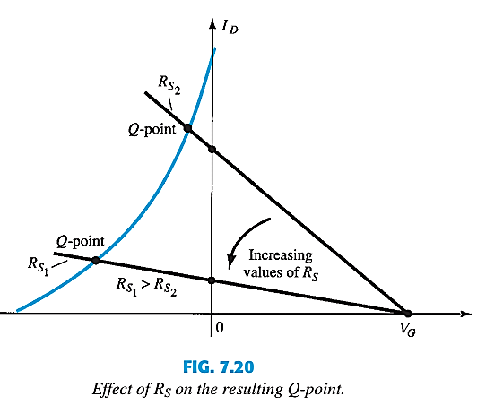
EFFECT OF INCREASING VALUES OF R_{S}

Slide 10
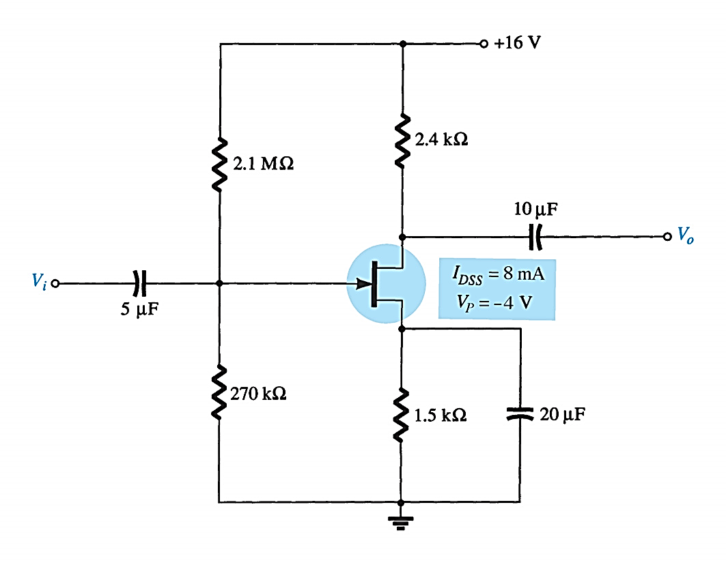
JFET: VOLTAGE-DIVIDER BIAS EXAMPLE
Determine I_{DQ}, V_{GSQ}, V_{D}, V_{S}, V_{DS} and V_{DG}.

Slide 11
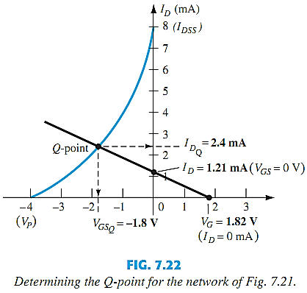
VOLTAGE-DIVIDER BIAS EXAMPLE Contd.
Graphical Approach ( to find V_{GSQ} and I_{DQ}):
Plot a line for:
V_{GS} = V_{G} when I_{D} = 0A
V_{GS} = 0V when I_{D} = V_{G}/R_{S}.
Plot the transfer curve using I_{DSS} and V_{P} using shorthand method.
Identify the Q-point.

Slide 12
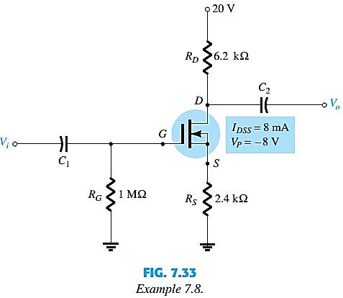
D-MOSFET SELF-BIAS
D-MOSFET bias circuits are similar to JFETs.
The only difference is that D-MOSFETs can operate with positive values of V_{GS} and with I_{D} values that exceed I_{DSS}.

Slide 13
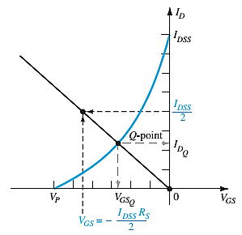
D-MOSFET SELF-BIAS
Graphical Approach (to find V_{GSQ} and I_{DQ}):
Plot the transfer curve using I_{DSS} and V_{P} using shorthand method.
Plot I_{D} vs V_{GS} using V_{GS} = -I_{D}R_{S}.
Take a positive value of V_{GS} and find the I_{D} value using
The Q-point is located at the intersection.

Slide 14
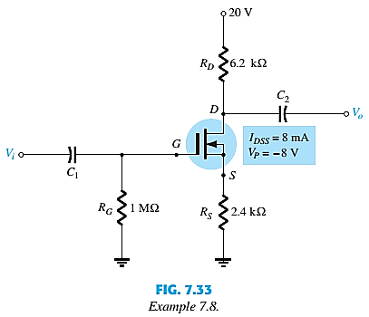
D-MOSFET SELF-BIAS EXAMPLE
Determine the I_{DQ}, V_{GSQ} and V_{D}.
Graphical Approach (to find V_{GSQ} and I_{DQ}):
Plot the transfer curve using I_{DSS} and V_{P} using shorthand method.
Take a positive value of V_{GS} and find the I_{D} value using
Plot I_{D} vs V_{GS} using V_{GS} = -I_{D}R_{S}.
Identify the intersection Q-point.

Slide 15
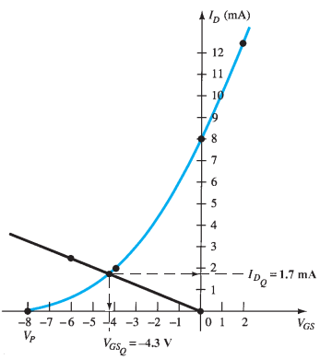
D-MOSFET SELF-BIAS EXAMPLE
V_{GSQ} = -4.3 V
I_{DQ} = 1.7 mA
V_{D} = 9.46 V

Slide 16
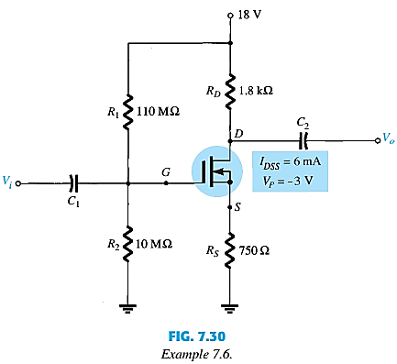
D-MOSFET VOLTAGE-DIVIDER BIAS
D-MOSFET bias circuits are similar to JFETs.

Slide 17
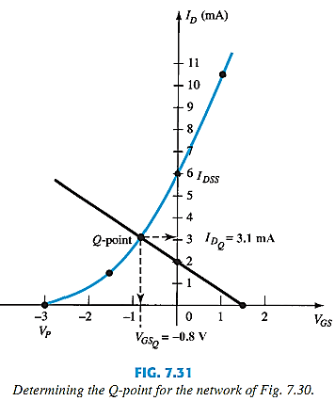
D-MOSFET VOLTAGE-DIVIDER BIAS
Graphical Approach (to find V_{GSQ} and I_{DQ}):
Plot the transfer curve using I_{DSS} and V_{P} using shorthand method.
Take a positive value of V_{GS} and find the I_{D} value using
Plot I_{D} vs V_{GS} using V_{GS} = V_{G} - I_{D}R_{S}.
The Q-point is located at the intersection.

Slide 18
End of Lecture-7

